Slide 1
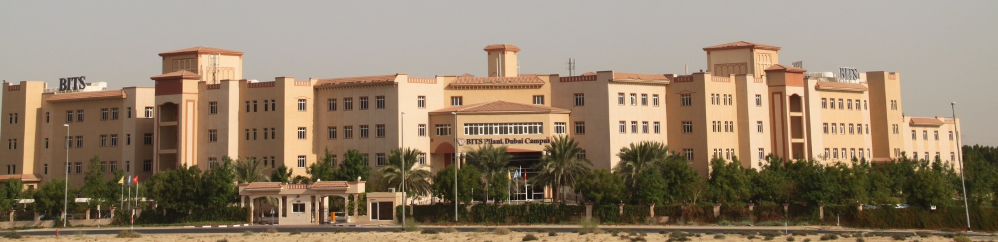
CS F342: Comp Architecture

Slide 2
About the Course
Course No. : CS F342 (3 1 4)
Course Title : Computer Architecture
LAB1:
Familiarization with MIPS Assembly Lang and QtSPIM

Slide 3
MP&IF vs CA/CO Course
In MP& I Course
Software : x86 instruction set & programing in x86 assembly level program
Hardware : Programmer’s view of the x86 Processor.
(how instruction are executed).
Interfacing.: memory, peripherals – 8255,
Labs
TASM/TLINK/TD in dosbox
Can you execute an asm program in linux (if so how)
CA/CO: How is a processor designed :
We could have studied processor design using x86 (simplified ver).
But not so..
Microprocessor without Interlocked Pipelined Stages (MIPS) Processor (why not x86)
x86 : CISC processor,
MIPS Processor - RISC…
=> MIPS Instruction Set and Assembly Lang Program
=> Design of MIPS (simplified vers).

Slide 4
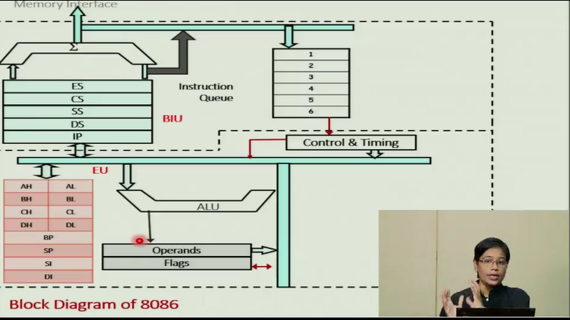
MP& I vs CA/CO Course
MP Labs
TASM/TLINK/TD in dosbox (why??)
Can you execute an asm program in linux (if so how)
C:> tasm a1;
C:> tlink a1;
C:> a1
aaa
C:> td a1
.model small
.data
msg1 db “aaa", 0dh, 0ah, "$"
.code
main proc
mov ax,seg msg1
mov ds,ax
mov ah,09
lea dx,msg1
int 21h
mov ax,4c00h
int 21h
main endp
end main

Slide 5
MP&IF vs CA/COCourse
CA Labs
How do you assemble, link and execute MIPS asm progs on x86 CPU ?
Is this solution ok ?
On an intel (x86) machine can we do the following? (Yes/No)
C:> mips_asm a1; (similar to tasm a1)
C:> mips_link a1; ( tlink a1)
C:> a1 ( execue a1)
aaa
C:> mips_debugger a1 ( TD A1)
.

Slide 6
QTSPIM
CA Labs
How do you assemble, link and execute MIPS asm progs on x86 cpu?
Ans:
An executable binary (a.exe) for given processor arch cannot be directly executed on another processor arch.
So what is the solution??
Architectural Simulator:
Simulator is also a software program.
Capable of executing binary code of another processor (say mips, arm etc)
Have you worked with anything like this in 3rd sem.

Slide 7
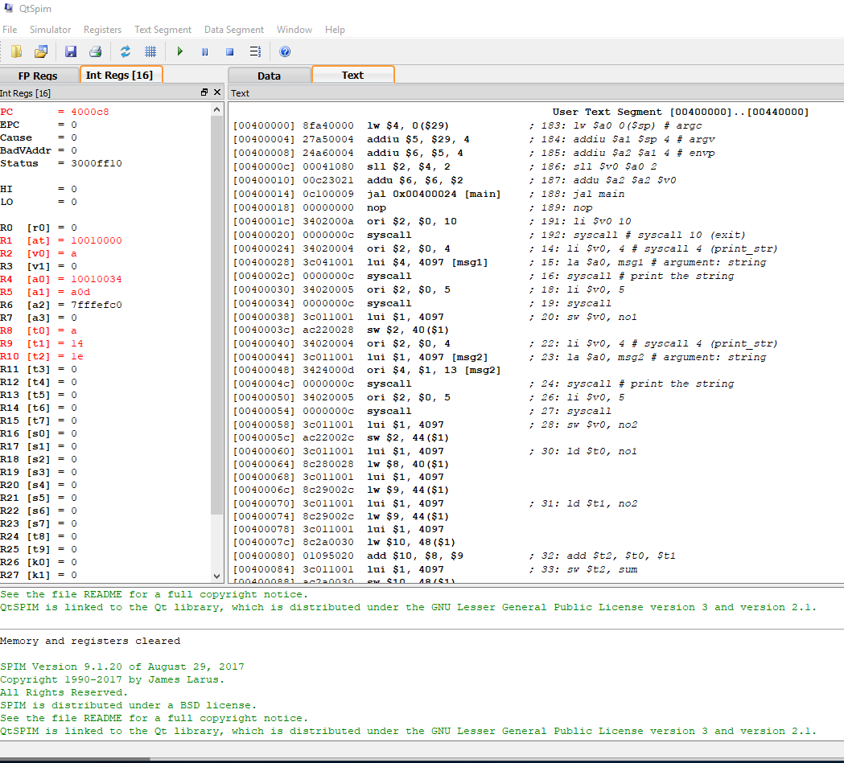
QTSPIM DEMO
QtSPIM (By James Laraus, Prof @wisc-mad, now @ms)
Simulator for mips processor (has an assembler also)

Slide 8
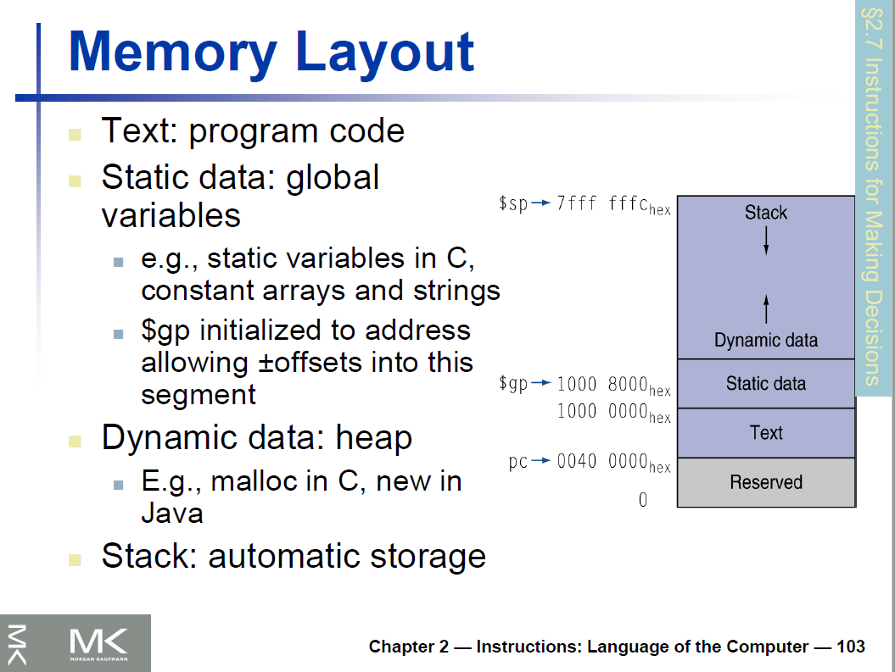
Memory Layout- MIPS

Slide 9
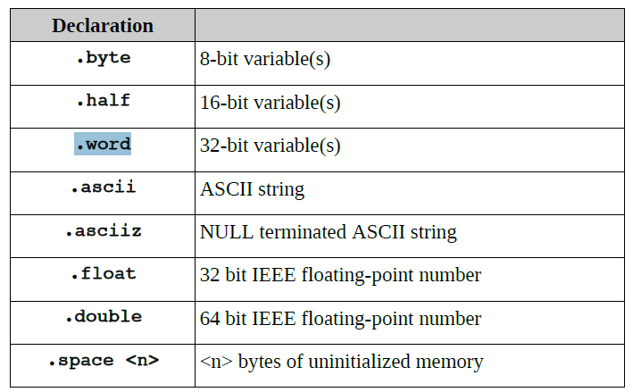
Data Declarations

Slide 10
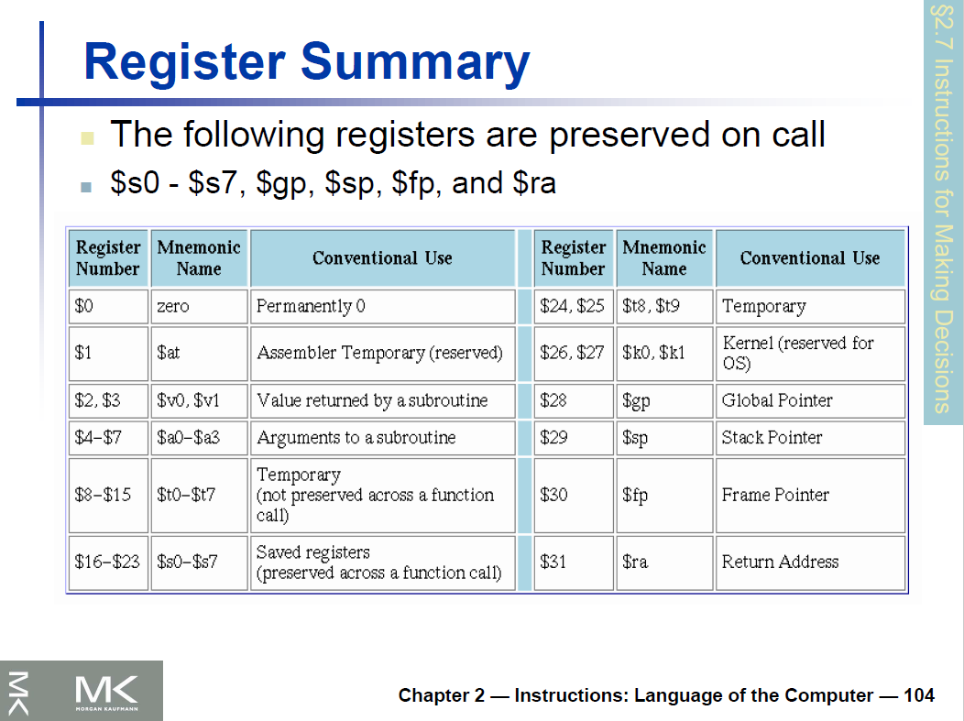
Register Summary

Slide 11
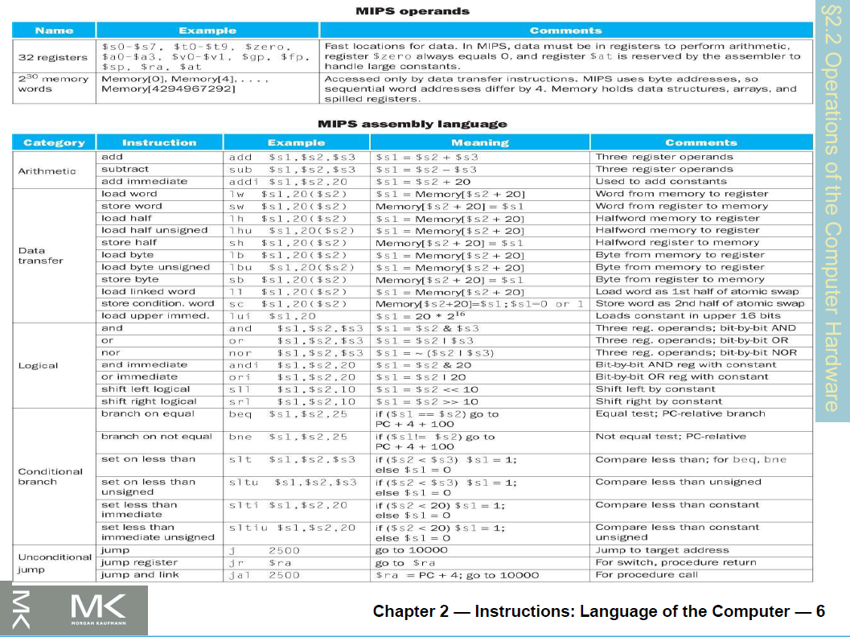
MIPS Instruction set

Slide 12
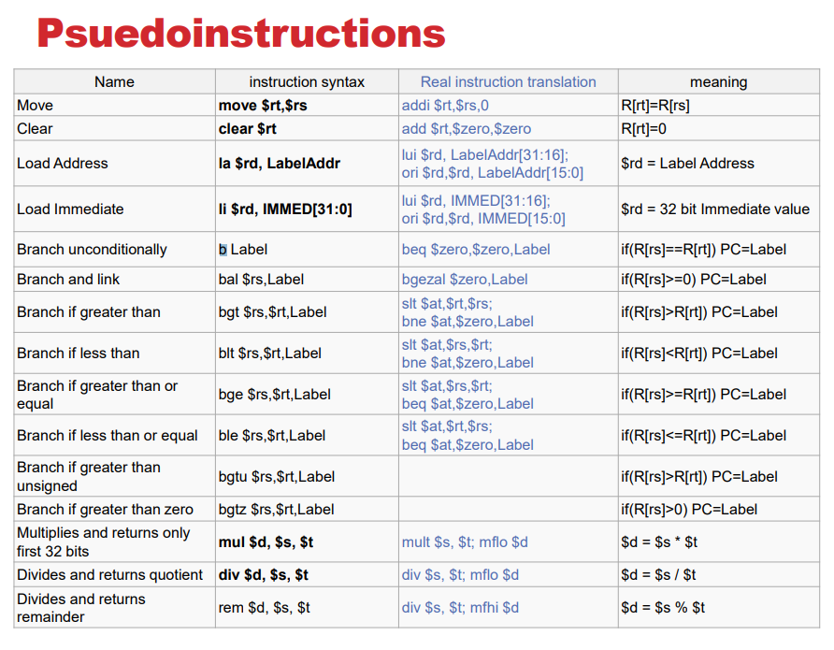
Psuedoinstructios

Slide 13
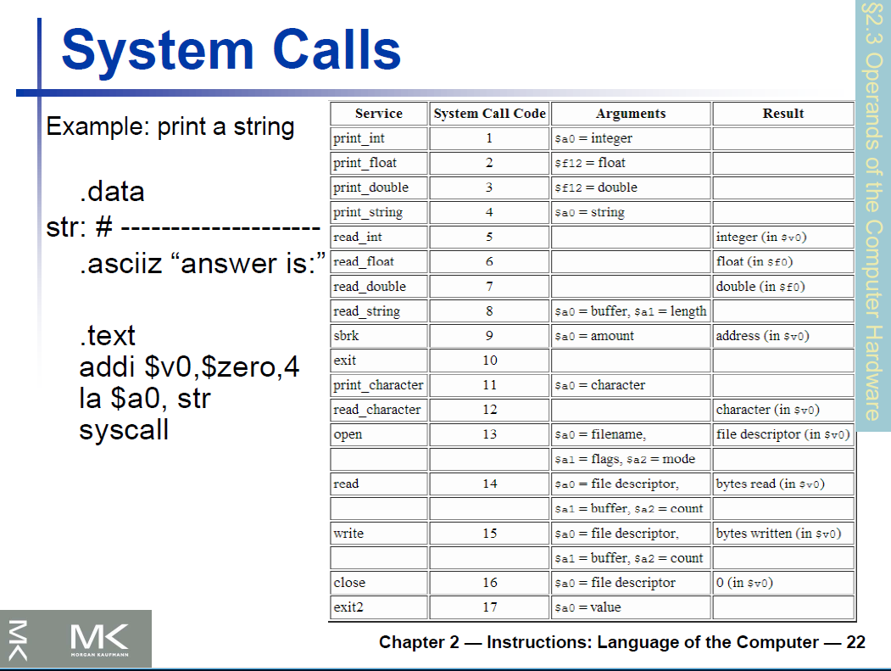
What is a CA/CO

Slide 14
MIPS Assemble Lang Prog
.data
msg: .asciiz "Hello World"
.text
main: li $v0, 4 # syscall 4 (print_str)
la $a0, msg # argument: string
syscall # print the string
li $v0, 10 #
syscall #
.model small
.data
msg1 db “aaa", 0dh, 0ah, "$"
.code
main proc
mov ax,seg msg1
mov ds,ax
mov ah,09
lea dx,msg1
int 21h
mov ax,4c00h
int 21h
main endp
end main

